Slide 1
MSE 311: Thermodynamics of Materials
Lecture 14: Subregular solution
Weishu Liu
Department of Materials Science and Engineering
Southern University of Science and Technology (SUSTech)
Email: liuws@sustech.edu.cn
Office: North Tower, Rm310

Slide 2
34. The Statistic explanation II
Ref. Introduction of Thermodynamics of Materials, D. R. Gaskell, Chapter 9

Slide 3
A-B-C ternary system solid solution
A-B-C ternary system solid solution has 6 types of Adjacent atomic pairs: A-A,B-B,C-C,A-B,B-C,C-A.
A-B binary system
z：the number of neighbor atoms

Slide 4
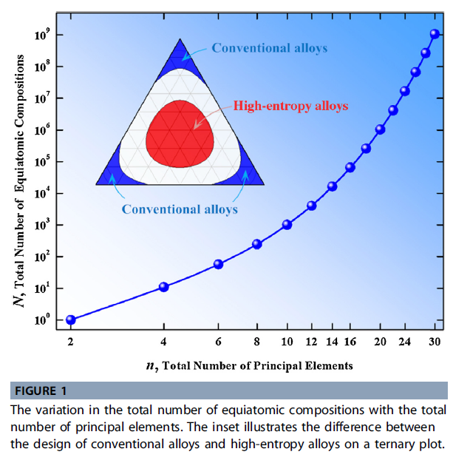
A-B-C ternary system solid solution
High entropy alloy!!
For the X_{A}=X_{B}=X_{C}=1/3
For n component system, X_{i}=1/n

Slide 5
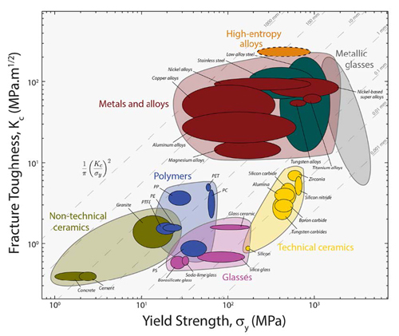
Tough and strong

Slide 6

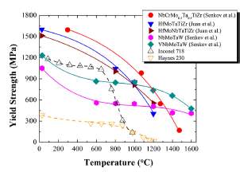
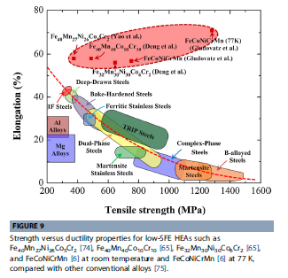
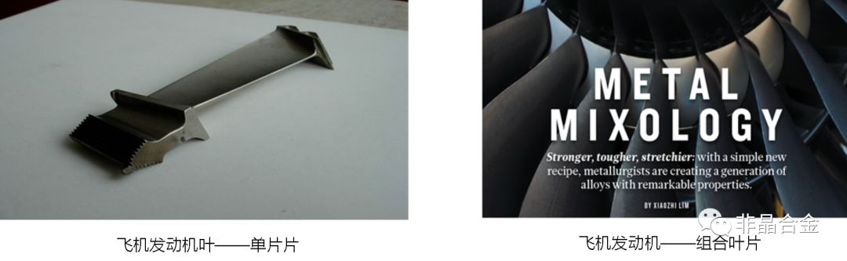

Slide 7
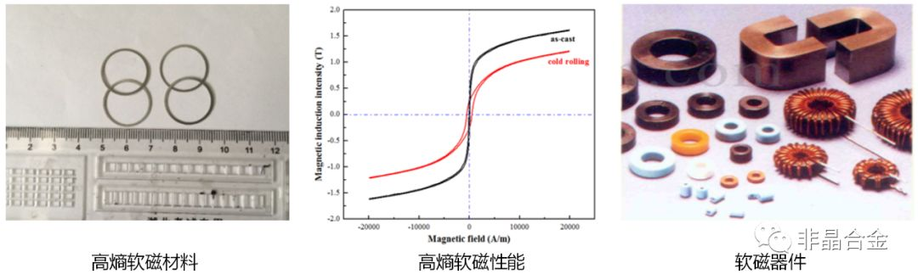

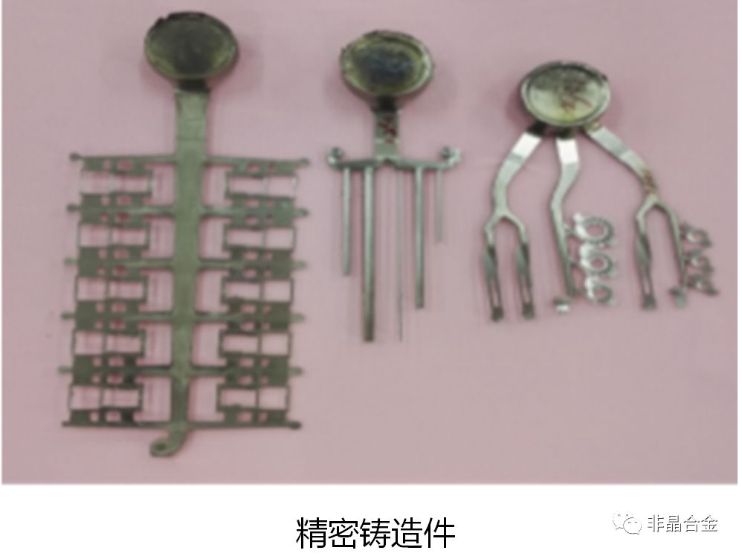

Slide 8
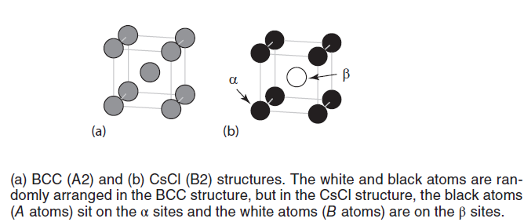

Consider atomic Ordering
Consider the ordering transformation of a random A – B solution phase
long-range order parameter (LRO), η [eta]
X_{i=A,B}, the fraction of the component I
Y_{j=α,β} , the fraction of lattice site j
r _{j= α,β} is the fraction of j sites that are “ rightly” occupied

Slide 9

Consider atomic ordering
For the BCC (random) → B2 (ordering) transformation of equiatomic alloy,
Y _{α} and Y _{β} are 1/2 , X _{A}= X_{B} = 1/2.
If all the α site are occupied by A atoms, r_{α} = 1 and η=1
If all the α site are occupied by B atoms, r_{α} = 0 and η=1
If all the α site are randomly occupied, r_{α} = 1/2 and η=0
Prove :

Slide 10
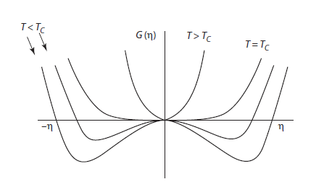

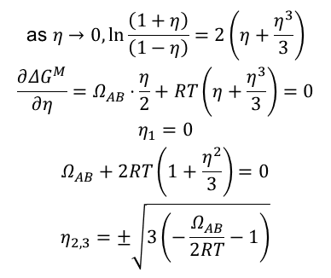
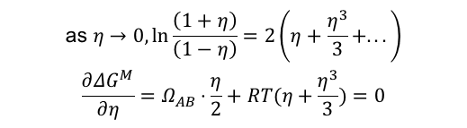
$$\begin{matrix}\text{as} η→0,ln\frac{\left(1+η\right)}{\left(1−η\right)}=2\left(η+\frac{η^{3}}{3}+...\right) \\ \frac{∂ΔG^{M}}{∂η}=Ω_{AB}⋅\frac{η}{2}+RT(η+\frac{η^{3}}{3})=0\end{matrix}$$
$$\begin{matrix}\text{as} η→0,ln\frac{\left(1+η\right)}{\left(1−η\right)}=2\left(η+\frac{η^{3}}{3}\right) \\ \frac{∂ΔG^{M}}{∂η}=Ω_{AB}⋅\frac{η}{2}+RT\left(η+\frac{η^{3}}{3}\right)=0 \\ η_{1}=0 \\ Ω_{AB}+2RT\left(1+\frac{η^{2}}{3}\right)=0 \\ η_{2,3}=±\sqrt{3\left(−\frac{Ω_{AB}}{2RT}−1\right)}\end{matrix}$$
$$Ω_{AB}=zN_{0}\left(E_{AB}−\frac{1}{2}\left(E_{AA}+E_{BB}\right)\right)<−2RT$$

Slide 11



Including Second-Neighbor Interactions
first-neighbor interactions energy
Second-neighbor interaction energies
the heat of transformation

Slide 12
35. Subregular Solutions
Ref. Introduction of Thermodynamics of Materials, D. R. Gaskell, Chapter 9

Slide 13
Excess Molar Gibbs Free Energy
- Excess value: different between its actual value and the value that it would have if the solution were ideal
G: molar Gibbs free energy of the solution
G^{id}: molar Gibbs free energy of the solution if it is ideal
G^{XS}: excess molar Gibbs free energy
Gibbs free energy before mixing G’:
Gibbs free energy after mixing G’’:

Slide 14

Excess Molar Gibbs Free Energy
For any solution
For Regular solution
For the solution with atomic ordering:

Slide 15
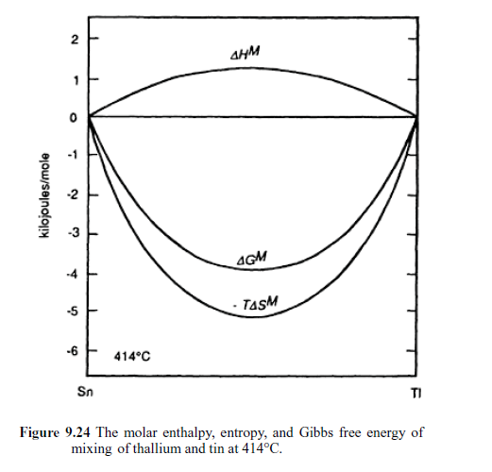
Excess Molar Gibbs Free Energy
Regular Solution
if
then
If only configurational entropy is considered, then Δ S ^{M} < Δ S ^{M ,id .}
If, however, other aspects of entropy exist in the alloy (e.g., magnetic spins, defects, volume effects), Δ S ^{M} may be greater than Δ S ^{M ,id .}

Slide 16
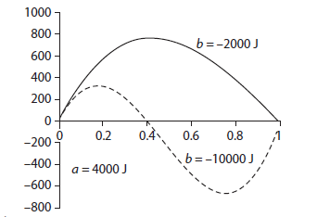
Subregular Solutions
If we make more flexible(suitable for more solutions)
For subregular solution, all factors except a and b are equal zero.
So
These figures are not symmetric at X_{A}=0.5 any more

Slide 17
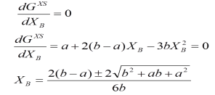
Subregular Solutions
If we know a and b,
we can determine the relationship between G^{XS} and compositions by
To determine maxima and minima,
Regular solution

Slide 18
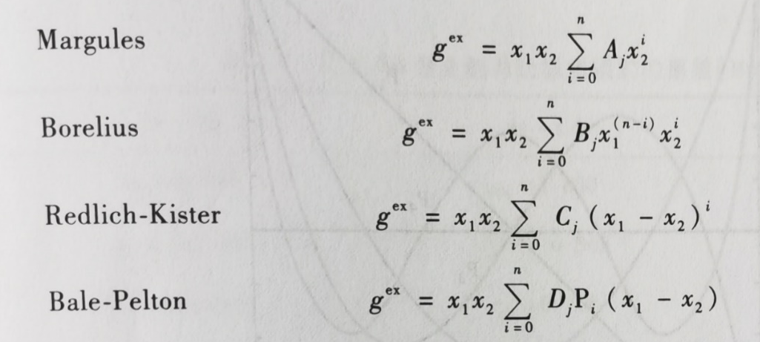
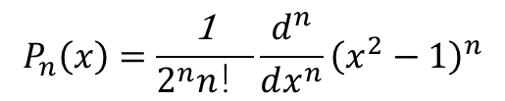
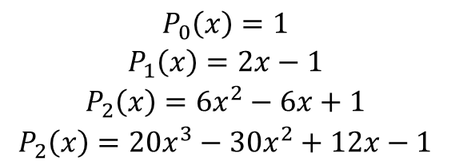
Subregular Solutions
Binary system
$$P_{n}\left(x\right)=\frac{\text{1}}{2^{n}n！}\frac{d^{n}}{dx^{n}}{\left(x^{2}−1\right)}^{n}$$
$$\begin{matrix}P_{0}\left(x\right)=1 \\ P_{1}\left(x\right)=2x−1 \\ P_{2}\left(x\right)=6x^{2}−6x+1 \\ P_{2}\left(x\right)=20x^{3}−30x^{2}+12x−1\end{matrix}$$

Slide 19
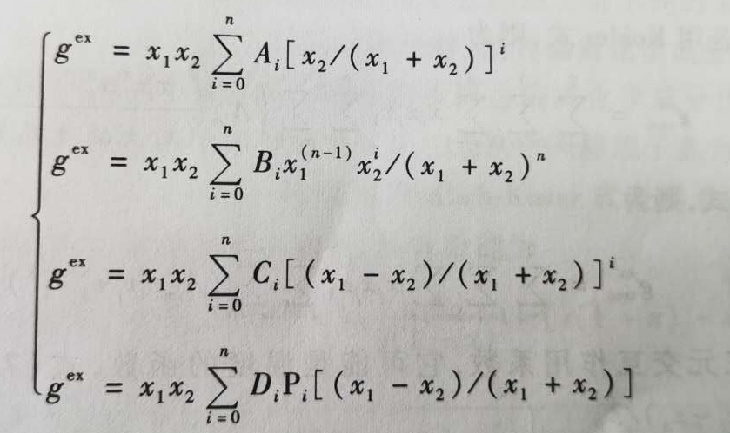
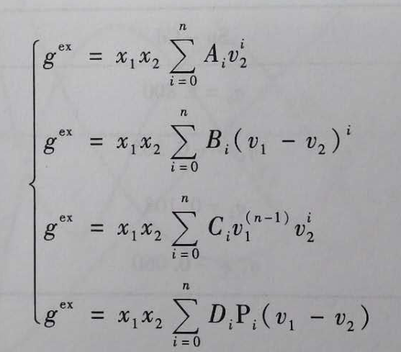
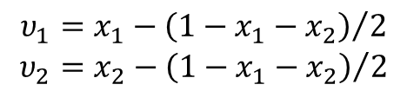
Subregular Solution-Engineering approach
Ternary system
Hillert, 1980
$$\begin{matrix}υ_{1}=x_{1}−{\left(1−x_{1}−x_{2}\right)}/2 \\ υ_{2}=x_{2}−{\left(1−x_{1}−x_{2}\right)}/2\end{matrix}$$

Slide 20

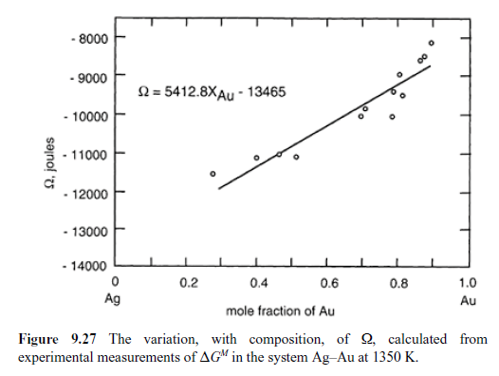
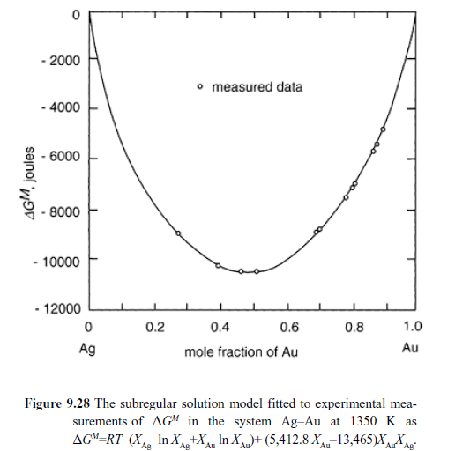
Subregular Solutions

Slide 21

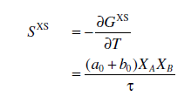
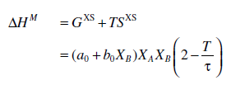
Effect of Temperature
regular
Subregular
The influence of temperature on the behavior of subregular solutions is accommodated by introducing a third constant, τ ,

Slide 22



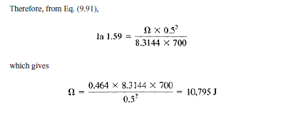


Numerical example
At 700 K, the activity of Ga in a liquid Ga– Cd solution of composition X Ga = 0.5 has
the value 0.79. On the assumption that liquid solutions of Ga and Cd exhibit regular
solution behavior, estimate the energy of the Ga– Cd bond in the solution. The molar
enthalpies of evaporation of liquid Ga and liquid Cd at their melting temperatures
are, respectively, 270,000 and 100,000 J.

Slide 23
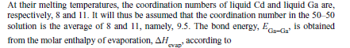

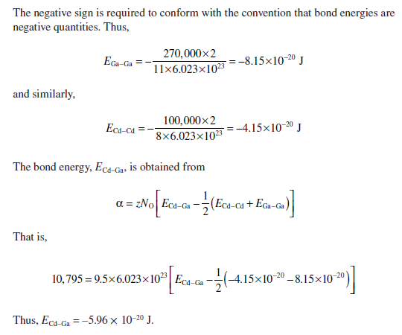

$$Ω=zN_{0}\left[E_{Cd−Ga}−\frac{1}{2}\left(E_{Cd−Cd}+E_{Ga−Ga}\right)\right]$$

Slide 24
36. Sublattice solid solution
Ref. 第四章，材料热力学 郝世明，第二版，北京化工出版社
第三章，微观组织热力学，西泽泰二，化学出版社

Slide 25
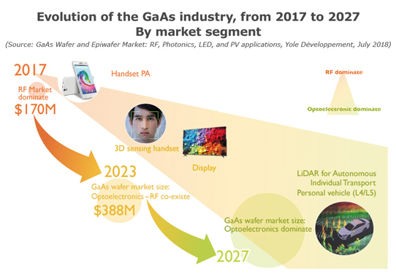
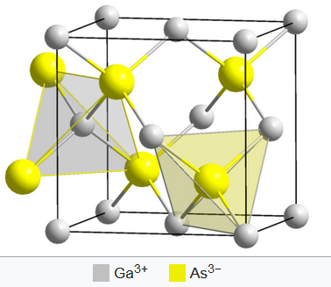
III-V Solid Solution
Structure of GaAs
III Group: Al, In, Ga
V Group: P, As, Sb

Slide 26
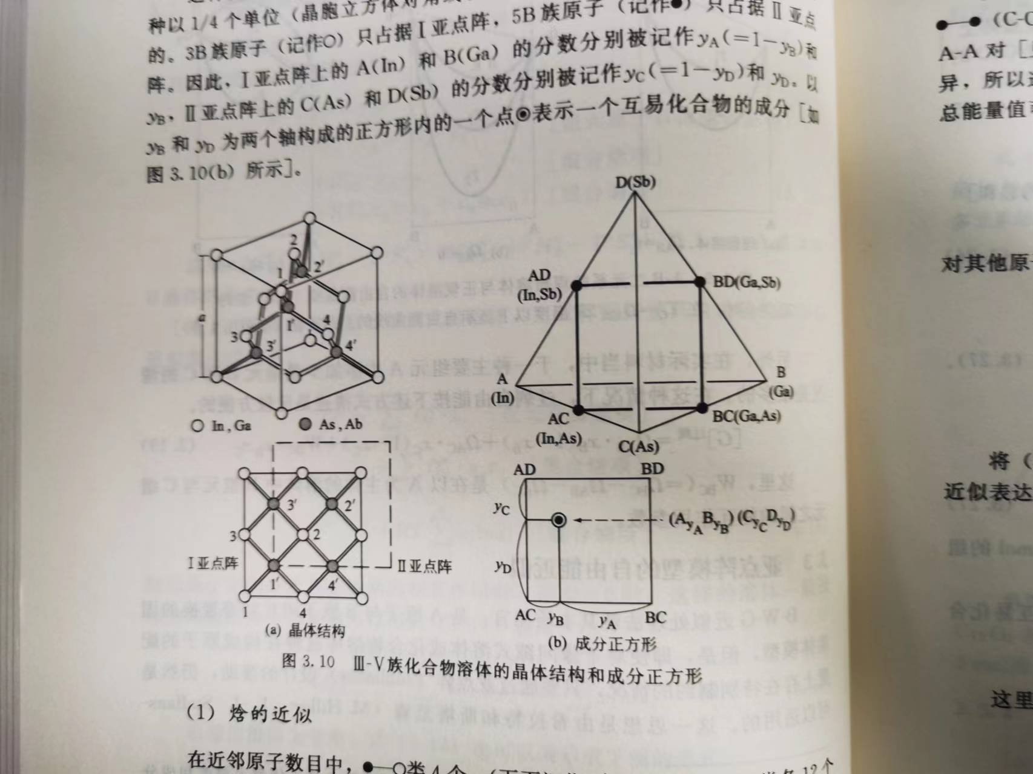
III-V Solid Solution
3B-sublattice
5B-sublattice
Neighbor’s number
z’ = 4
z = 12
z = 12

Slide 27
III-V Solid Solution
First neighbor
z’ = 4
z = 12
Second neighbor
z = 12
E_{AA}
For the 1-3 pair, it has to be a neighbor of 1‘ that could C or D
E_{BB}
E_{AB}
E_{CC}
E_{DD}
E_{CD}

Slide 28
Consider other atoms
The total entropy

Slide 29
Entropy
化合物组元熵
I-亚点阵列上的混合熵
II-亚点阵列上的混合熵
Gibbs free energy
组元自由能项
General express for (A,B)_{m} (C,D)_{n}

Slide 30
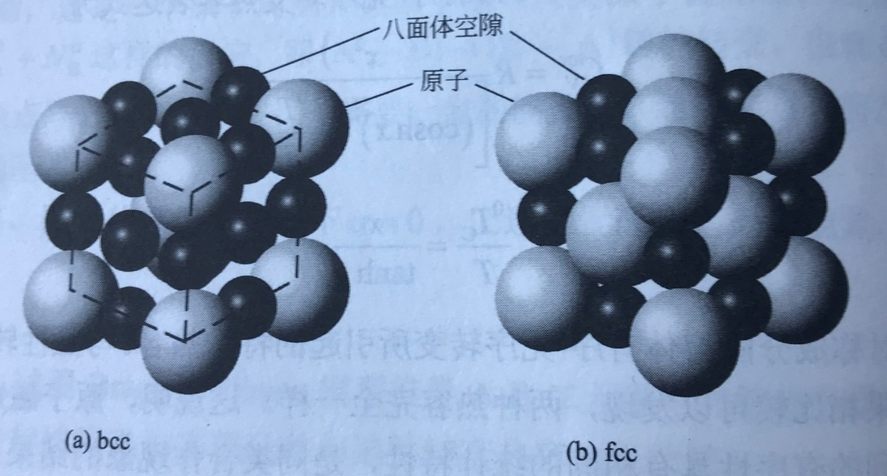
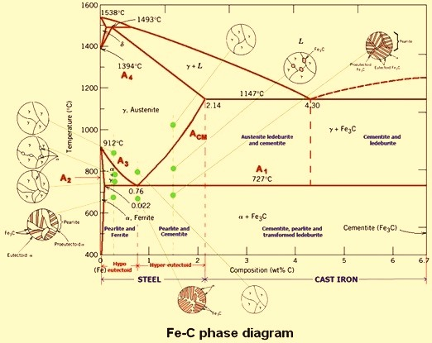
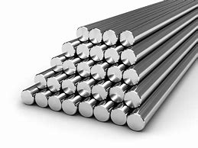
Interstitial solid solution
Simple solid solution: only one set lattice
Interstitial solid solution: two set sub-lattice
Entity sub-lattice , Fe, Cr, Mn, Mo
Void sub-lattice , C, O, H

Slide 31
Interstitial solid solution
Relationship of the Solid solution composition and sub-lattice composition ?
γ-solution of Fe (fcc)
Solid solution:
FeCrNiC
Fraction of element: X_{Fe} + X_{Cr} +X_{Ni}+X_{C} =1
Sublattice model:
(Fe, Cr, Ni)₁ (C, Va)₁
Va: vacancy
Entity sub-lattice
Void sub-lattice
y_{Fe} + y_{Cr} +y_{Ni}=1
y_{C}+ y_{Va} =1

Slide 32

Interstitial solid solution
Relationship of the Solid solution composition and sub-lattice composition ?
α-solution of Fe (bcc)
Solid solution:
FeSiMoiC
Fraction of element: X_{Fe} + X_{Cr} +X_{Ni}+X_{C} =1
Sublattice model:
(Fe, Si, Mo)₁ (C, Va)₃
Va: vacancy
Entity sub-lattice
Void sub-lattice
y_{Fe} + y_{Si} +y_{Mo}=1
y_{C}+ y_{Va} =1

Slide 33
Mixing entropy
Question: calculate the mixing entropy of α-solution of FeSiMoC ?
γ-solution of FeCrNiC (fcc)
(Fe, Cr, Ni)₁ (C, Va)₁
α-solution of FeSiMoC (bcc)
(Fe, Si, Mo)₁ (C, Va)₃
Hypothetical
compound
M_{a} N_{b}
Based the regular solution
For 1 mol M sub-lattice:
For 1 mol N sub-lattice:
For 1 mol M_{a}N_{b}:
For 1 mol α-solution :

Slide 34
Mixing Enthalpy
α-solution of FeSiMoC (bcc)
(Fe, Si, Mo)₁ (C, Va)₃
M_{a} N_{b}
For 1 mol M sub-lattice:
For 1 mol N sub-lattice:
For 1 mol M_{a}N_{b}:
For 1 mol α-solution :

